Slide 1

The Hybrid Bakery
FINAL PROJECT

Slide 2
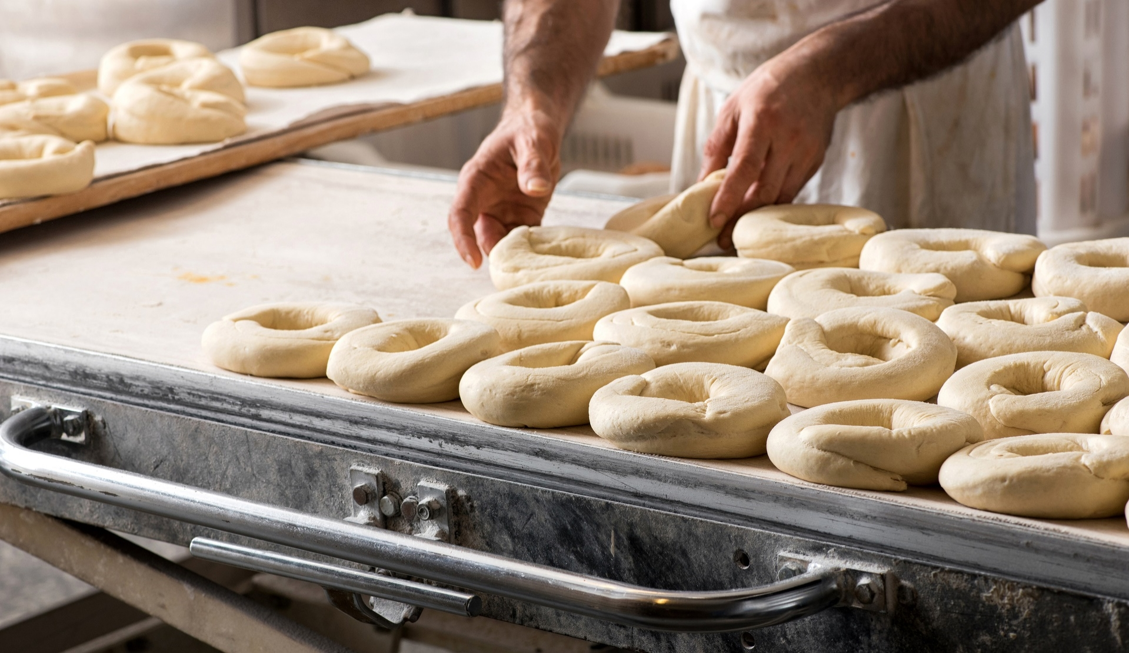
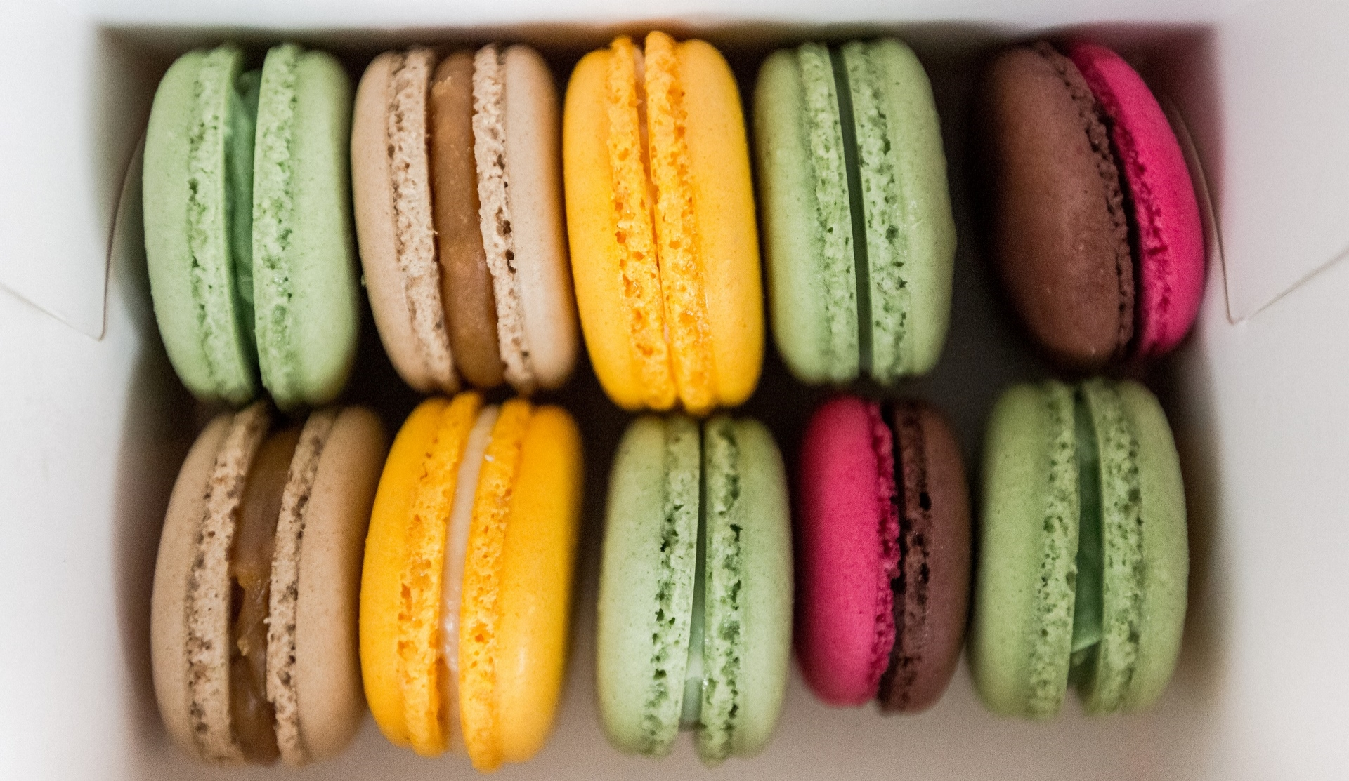
Members
Adila
Sarah
Jessica
Ayla
Fiona

Slide 3
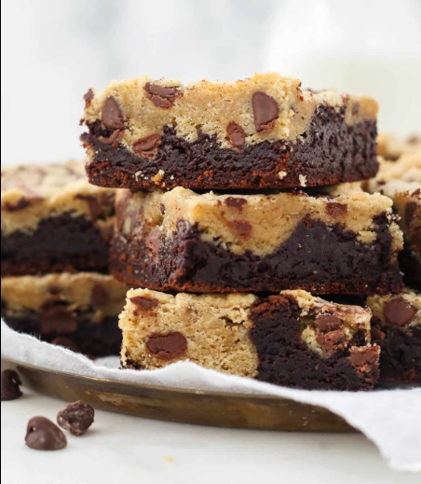
Agenda
- Members
Topic and user stories
Demo
Journey & Experience
Reflections
Feedback/Questions

Slide 4

TOPIC
The hybrid bakery
Shared love of sweet treats
Adila’s ‘Brookies’ (cookies x brownies).
Hybrid bakery app for staff and customers
First meeting
Looked at brief and decided on tasks
Created architecture and DB design
Came up with user stories

Slide 5
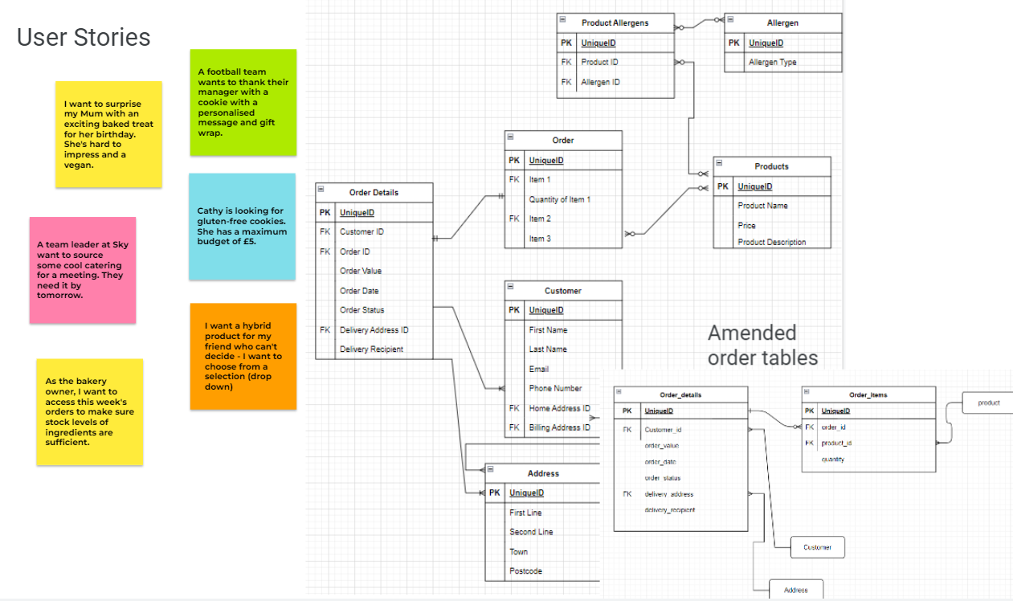
User stories

Slide 6
DEMO TIME!

Slide 7
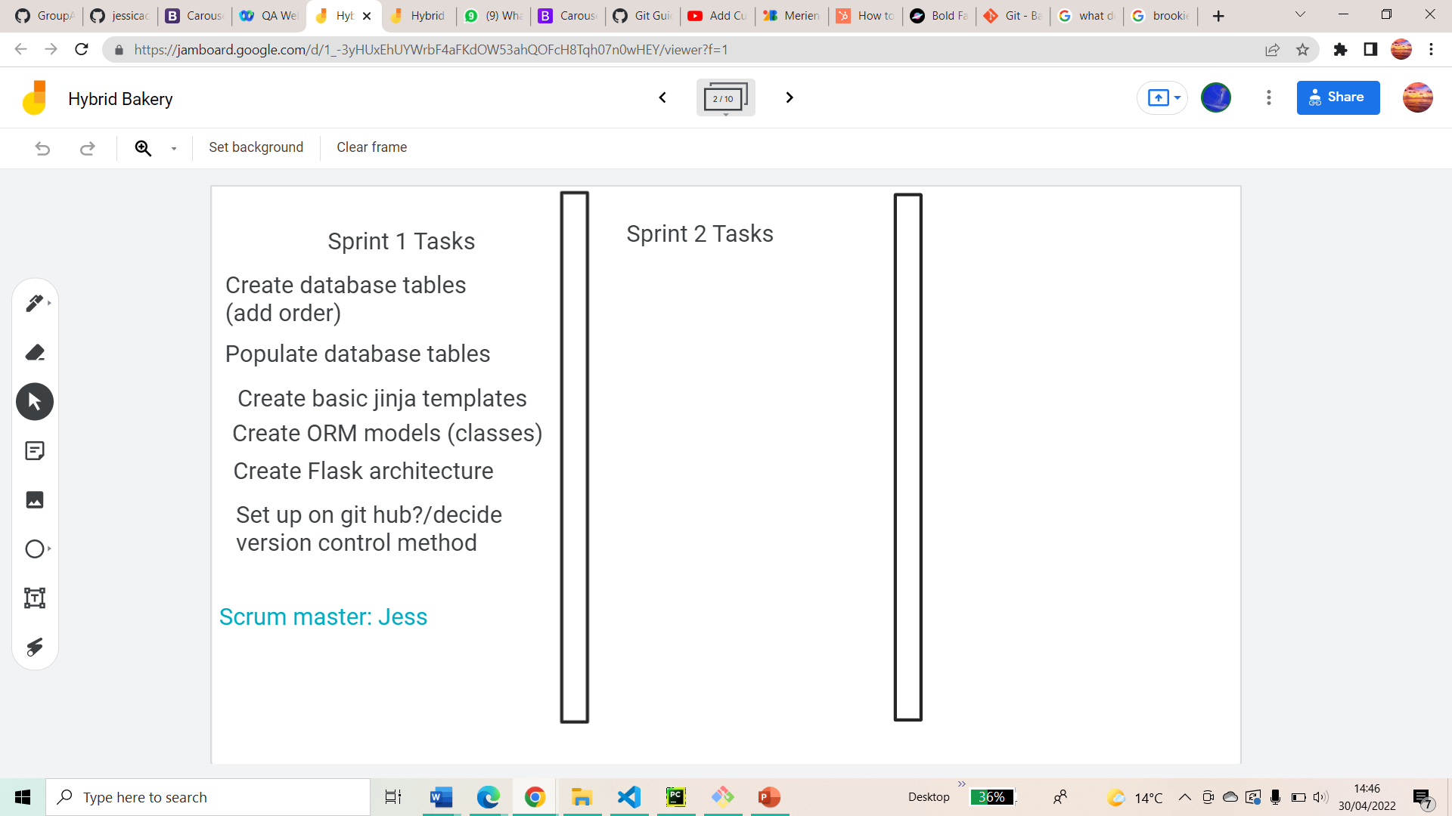
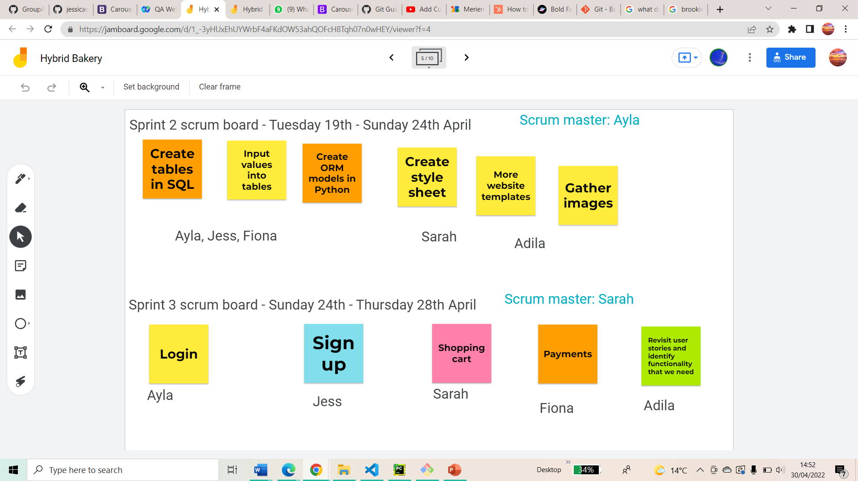

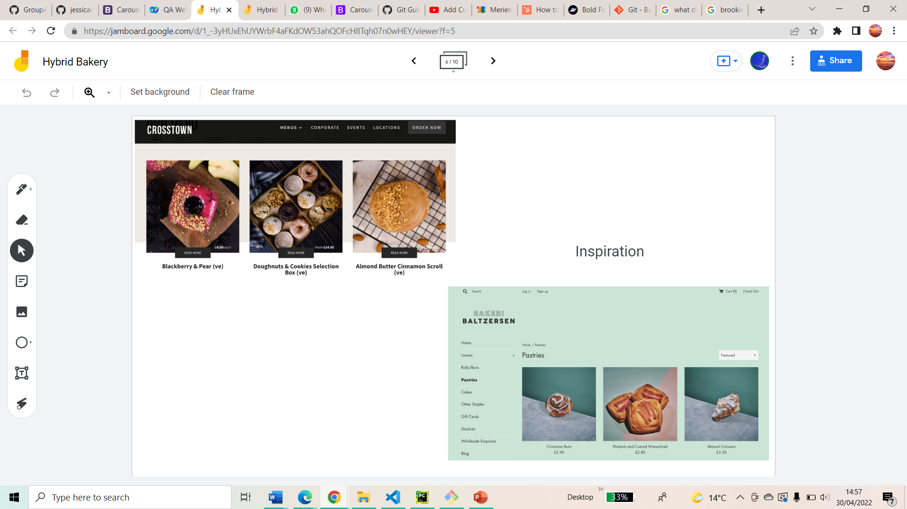
Journey & Experience
Sprint 1
- Scrum master - Jessica
Database
Flask Architecture
Github
Sprint 2
Scrum master – Ayla
Took Martina’s advice to create ‘a slice’ of the app including all elements in basic form.
Sprint 3
Scrum master – Sarah
Challenging tasks meant teamwork, research, tutorials and experimentation.
Levelled up our debugging skills!

Slide 8
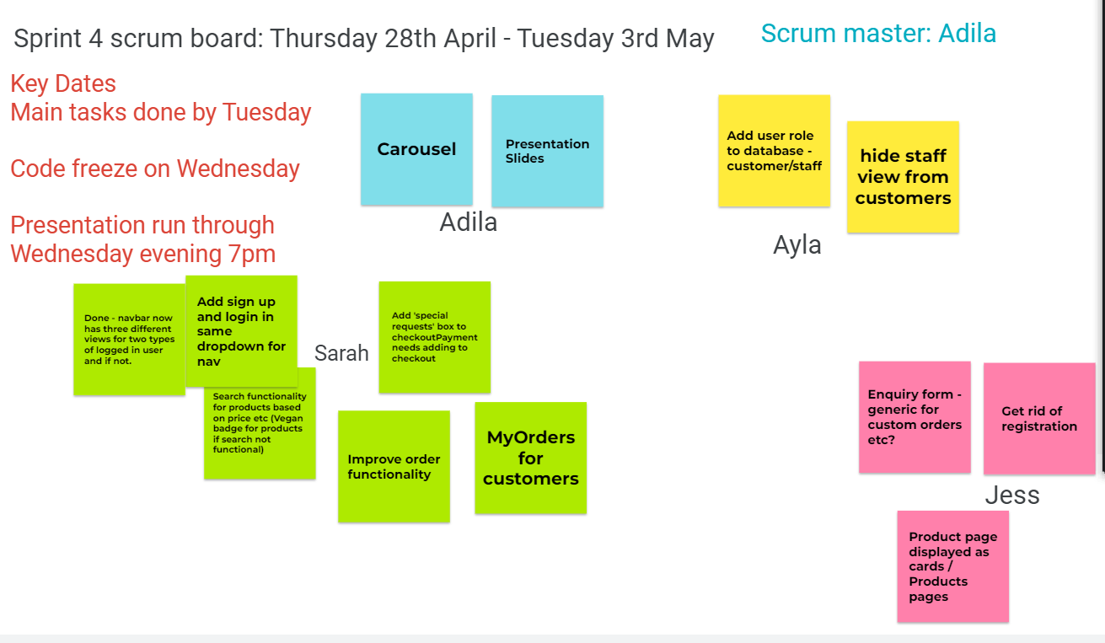
Sprint 4 – FINAL SPRINT
Sprint 4
Scrum master – Adila
Planning presentation
Finalising code for code freeze
Fixing any minor issues
Adding functionality
Styling the website/HTML/CSS
Presentation run through

Slide 9
Challenges
- Availability of team members
- Time constraints
- Different operating systems
-Version control
Solved by…
Agile - using the scrumboard
MVP
Google
GitHub
stand ups/ retrospectives

Slide 10
Achievements
Time management
GitHub
Agile working
Allocating tasks quickly to team members’ strengths
Team support and meetings when anyone did not understand an element of the work
A working website from scratch
Jinja
Flask
My SQL DB

Slide 11
Reflections
What went well?
What would we do differently?
What would we do next?
Agile working when team members had availability issues due to personal circumstances
Planning, making decisions and distributing tasks quickly and efficiently to keep work- flow going
Sprint tasks
Functionality of user stories
Spend more time on initial user stories to save time later
DB planning; Forms & logins
Final product planning/consistency
Ensure app fully integrates with database
Search function
Algorithms for product recommendations
Functionality for updating orders
More interactions (videos/ spinners)
Ensuring all elements are responsive for mobile app
Product filters (e.g. allergens/price etc)

Slide 12

THANK YOU
Feedback/Q&A

